Slide 1

Congressional DELETED TWEETS
Mohammed Nauman Siddique, Michele C. Weigle, Michael L. Nelson
Web Science and Digital Libraries Group
Old Dominion University
Norfolk, Virginia, USA
@WebSciDL

Slide 2
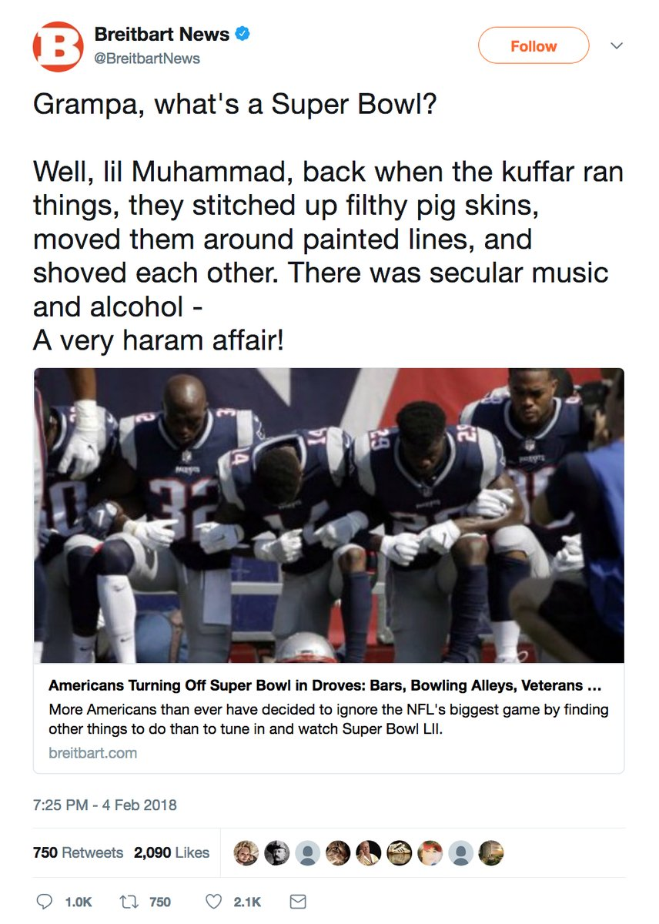
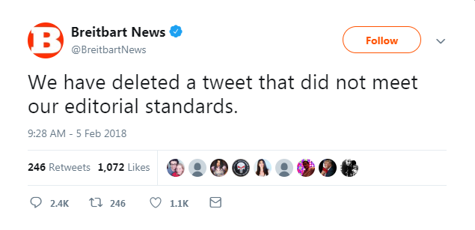
"Grampa, what's a deleted tweet?"
Deleted Tweet from Breitbart News
Apology Tweet From Breitbart News
Source: https://ws-dl.blogspot.com/2018/04/2018-04-23-
grampa-whats-deleted-tweet.html

Slide 3
Why do we care about deleted tweets?
11% of the shared resources are lost in their first year
After that we lose the shared resources at a rate of 0.02% per day
Source: SalahEldeen H.M., Nelson M.L. (2012) Losing My Revolution: How Many Resources Shared on Social Media Have Been Lost?. In: Theory and Practice of Digital Libraries. TPDL 2012. Springer, Berlin, Heidelberg

Slide 4
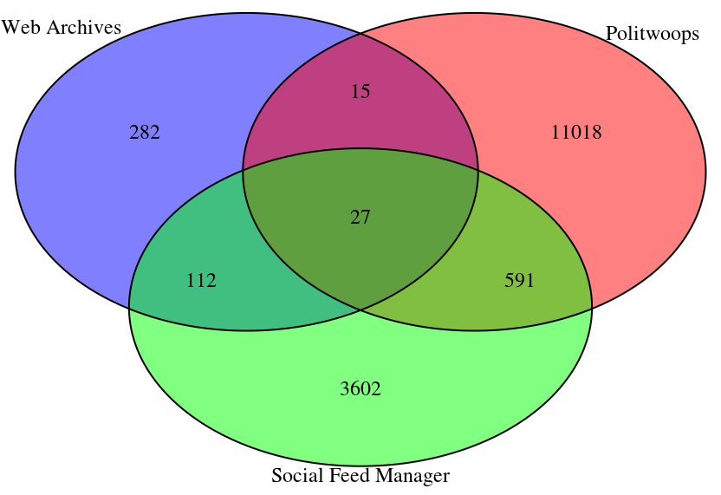
Congressional Deleted Tweets from January 2017 to July 2018
436
11651
4332

Slide 5
BACKUP SLIDES

Slide 6
Take Away Message
No one knows all the deleted tweets.

Slide 7
What are we doing about it?
Estimating total deleted tweets
Classifying deleted tweets on

Slide 8
Finding Congressional Deleted Tweets
Web Archives
Social Feed Manager
Politwoops

